Slide 1
Customer Support Chat Bot with ML
PIP2001 Capstone Project
Review-0
Batch Number: 2021- 2025
Under the Supervision of,
Prof. Harish Kumar
Professor / Associate Professor / Assistant Professor
School of Computer Science and Engineering
Presidency University
Roll Number | Student Name
20211CSG0069 20211CSG0049 20211CSG0046 20221lLCG0002 | ANTOSH SHIVA PRASAD SWAMY P U LEKHAN R
Name of the Program: Computer Science and Technology(CSG)
Name of the HoD: DR. Saira Banu Athem
Name of the Program Project Coordinator:
Name of the School Project Coordinators: Dr. Sampath A K / Dr. Abdul Khadar A / Mr. Md Ziaur Rahman

Slide 2
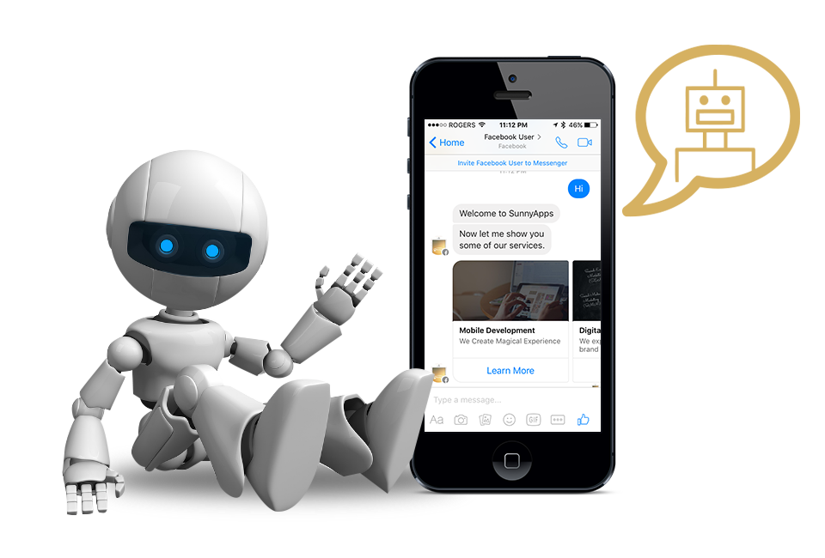
PROJECT TITTLE
Customer Support Chat BOT

Slide 3
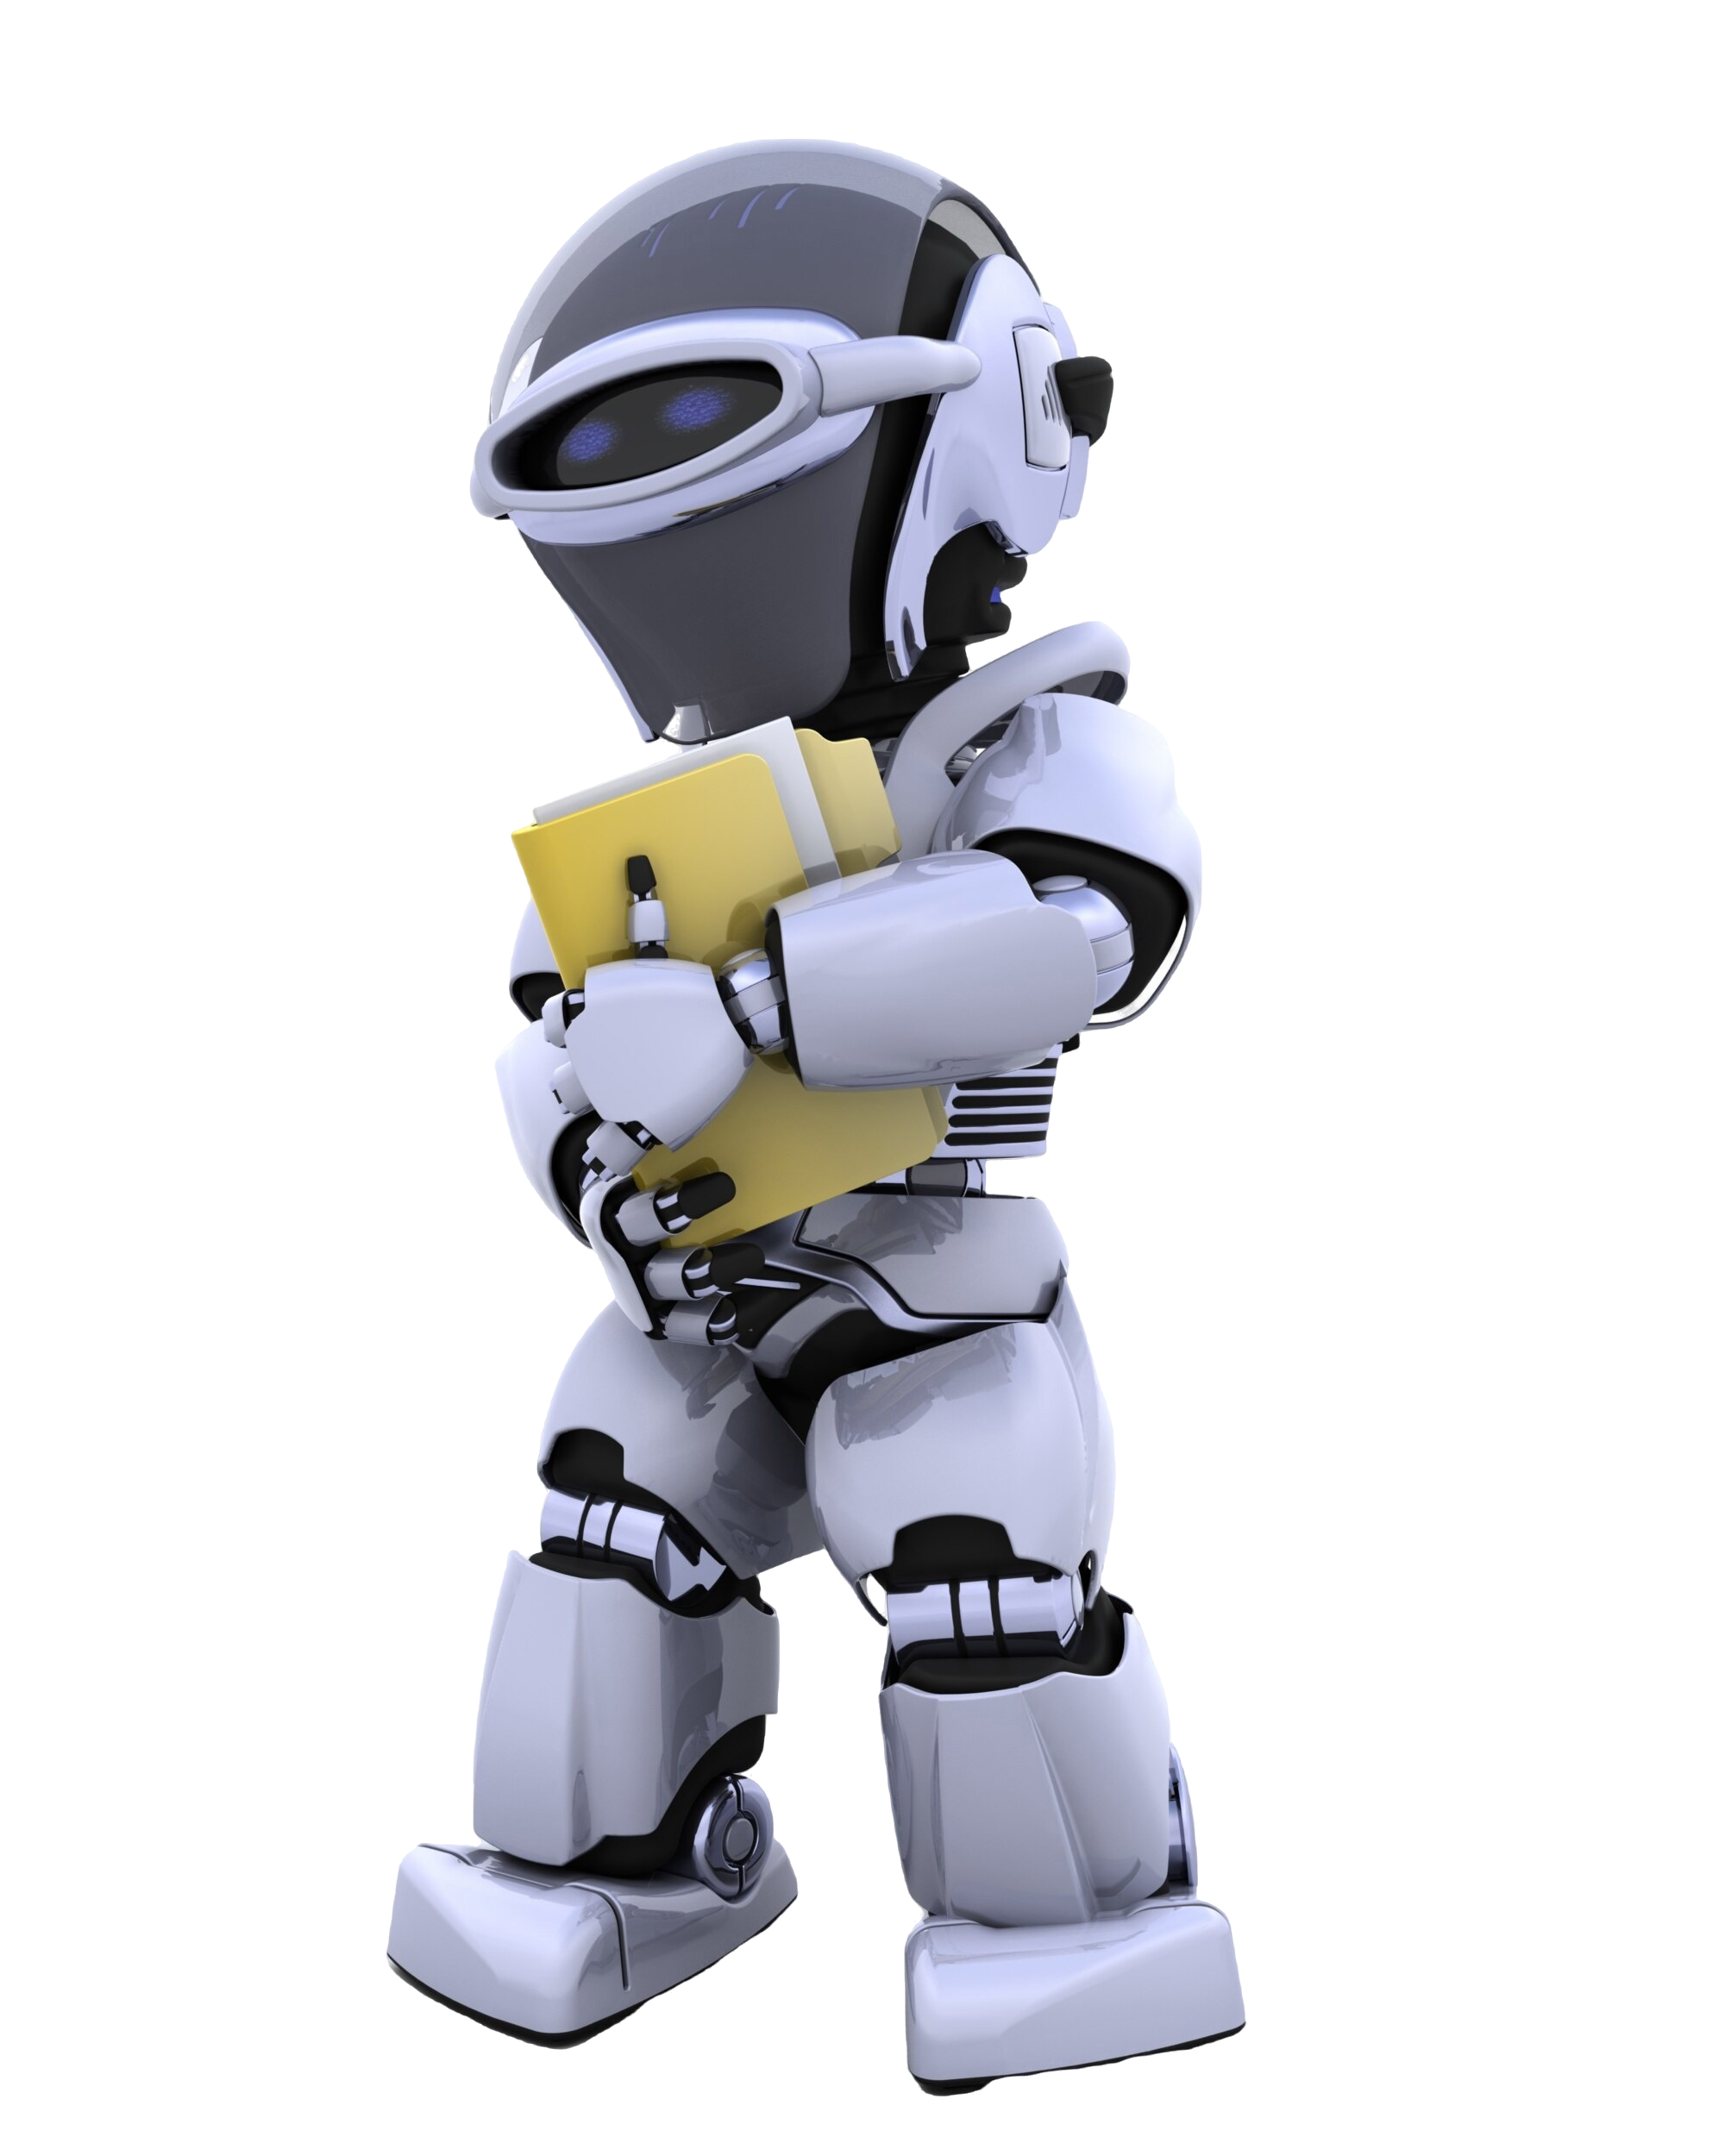
Content
Problem Statement
Analysis of Problem Statement
Timeline of the Project
References

Slide 4
Problem Statement Number:
Organization: KG Info Systems Pvt Ltd
Category (Hardware / Software / Both) : Software
Problem Description: A chat bot which can interpret the customer complaints or queries, search the DB for resolution and in case new solution found, hand it over to support staff. Based on the conversation b/w customer and staff, update the DB, be prepared to handle similar queries in future
Difficulty Level: Complex

Slide 5
Analysis of Problem Statement
Technology Stack Components:
To build a chatbot system for handling customer complaints and queries, you'll need several key technology components:
NLP Engine: OpenAI GPT-4, Dialogflow, or Microsoft LUIS.
Database: Relational (PostgreSQL, MySQL) or NoSQL (MongoDB).
Integration: Use RESTful APIs or GraphQL for system connections.
Machine Learning: TensorFlow to enhance response accuracy.
Support Interface: A UI for staff to manage unresolved issues and update the knowledge base..
Security: Ensure data protection and scalability.

Slide 6
Analysis of Problem Statement (contd...)
Software and Hardware Requirements:
To implement a chatbot system effectively, you'll need a combination of hardware and software components. Here’s a streamlined list of what's required:
Hardware Components
Servers:
Cloud-based Servers: AWS, Google Cloud, or Azure for scalability and reliability.
Network Infrastructure:
High-speed Internet Connection: Essential for smooth communication between the chatbot, users, and databases.
Load Balancers: To distribute incoming traffic efficiently across servers.
Backup Solutions:
Storage Devices: For data backup and recovery. Cloud storage options can also be used for ease of management.

Slide 7
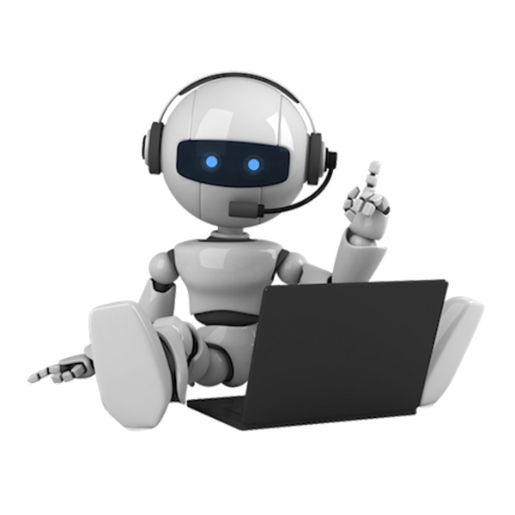
Analysis of Problem Statement (contd...)
NLP Tools:
OpenAI GPT-4, Dialogflow, Microsoft LUIS
Database Management:
Relational: PostgreSQL, MySQL
NoSQL: MongoDB, Couchbase
Integration & API:
API Management: Postman, Swagger
Message Queues: RabbitMQ, Apache Kafka
Machine Learning:
Frameworks: TensorFlow, PyTorch
Analytics: Google Analytics, Mixpanel
Support Interface:
Dashboard: Custom interfaces, CRM integration (Salesforce, Zendesk)
Support Software: Ticketing systems

Slide 8
User Interaction:
Chatbot Frameworks: Botpress, Rasa
Messaging Platform Integration: SDKs/APIs for Slack,
Facebook Messanger.
Security:
Firewall/Antivirus, Encryption Tools
Development & Deployment:
Version Control: GitHub, GitLab
CI/CD: Jenkins, GitLab CI4o

Slide 9
References (IEEE Paper format)
Add APA Citation for all references.
Amazon's Alexa for Customer Service:
Use Case: Amazon has integrated its virtual assistant, Alexa, to help users resolve queries related to their products or services. Alexa is able to respond to voice commands, track orders, and answer common support queries.
Impact: It provides 24/7 customer support without the need for human agents, significantly reducing waiting times and enhancing convenience.
Use the below link for various APA styles :
https://www.indeed.com/career-advice/career-development/how-to-cite-a-research-paper

Slide 10
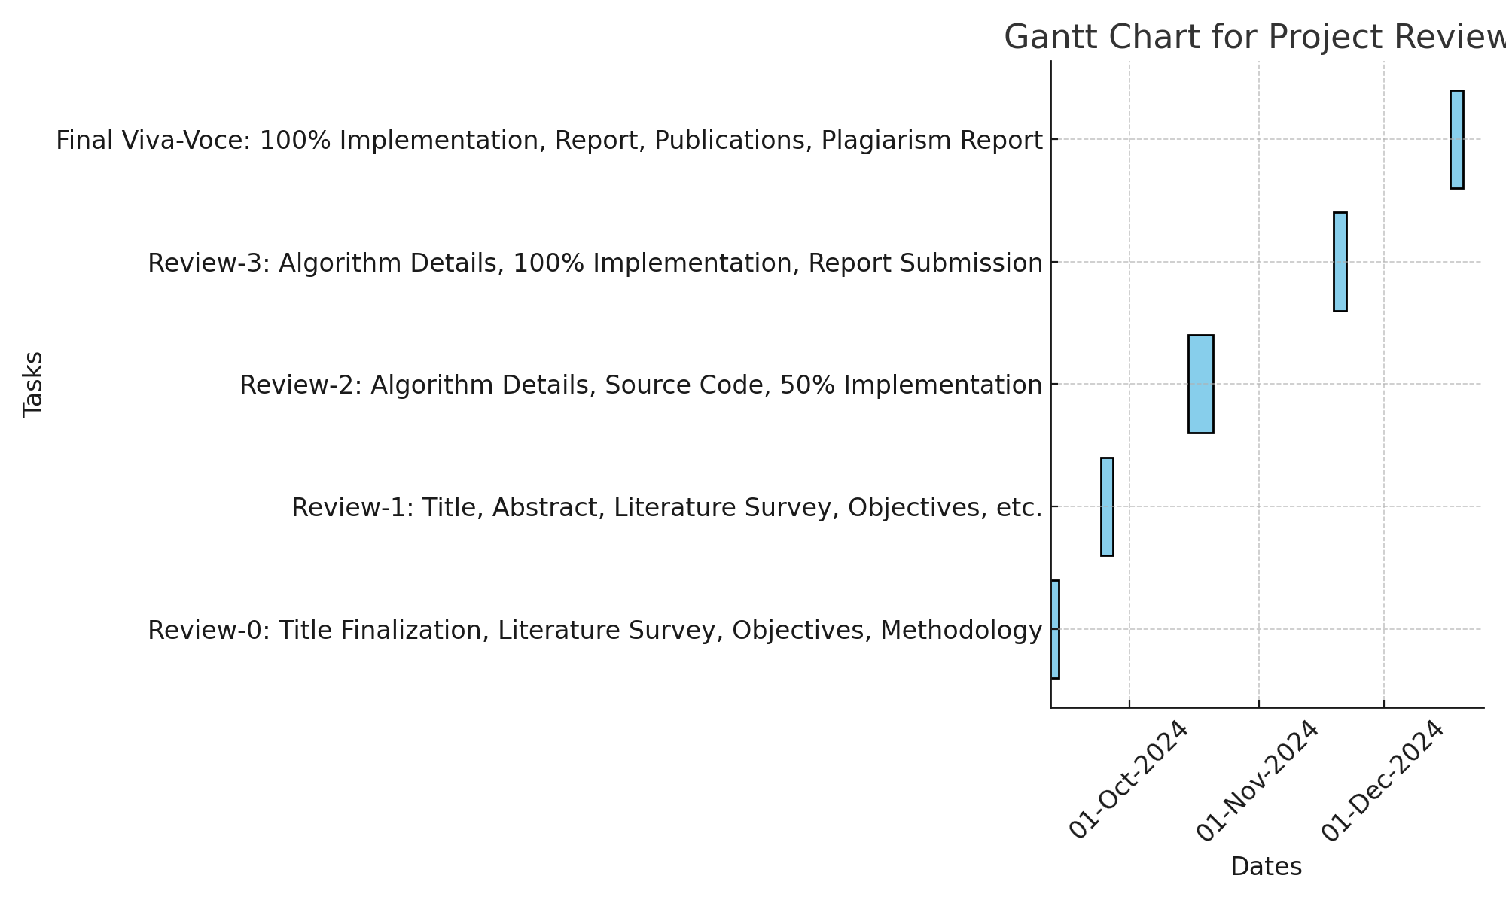
Timeline for project (Gantt chart)

Slide 11



